Slide 1
Web Development using R and Shiny
Saurav Ghosh
Bangalore R Users’ Group
October 6, 2018

Slide 2
What is shiny
Broadly..
Shiny is an R package that makes it easy to build interactive web apps straight from R.
Shiny combines the computational power of R with the interactivity of the modern web.

Slide 3
What is shiny contd…
Provides a framework for building web applications using R
Developer builds app with two main components: a server and a UI component
Users can generate all the html for the webpage using functions in R
The server executes R code that reacts to user-webpage interactions
Applications
display interactive R analyses and contain all the functionality of an R script
data loaded into R, calculations performed in R, plots built in R
can be shared as a webpage hosted on a server, accessible to users without R or RStudio

Slide 4
Structure of a shiny application
Basic app
Contains a single file, app.R
app.R
UI
Server
Basic template
library(shiny)
ui <- fluidPage()
server <-function(input, output){}
shinyApp(ui = ui, server = server )

Slide 5
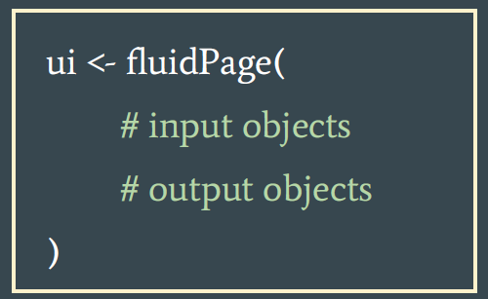
SHINY APP ARCHITECTURE
UI function
UI function generates the webpage
- Add elements to the webpage as
arguments to fluidPage()
- Reactive elements added as input/
output functions

Slide 6
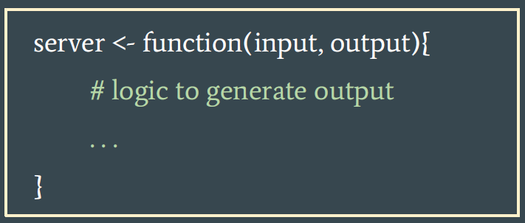
SHINY APP ARCHITECTURE
Server function to build reactive outputs
- Define output logic, using R code, that reacts to user- inputs and updates analyses
- Server arguments are input, output

Slide 7
INPUT elements
Input functions
- buttons, checkboxes, sliders, text, numeric input
inputID, unique identifier
- label, for display in the UI
- other arguments related to specific input types, e.g. default value

Slide 8
Output elements
Output functions are used to display plots, tables, images, text
- outputId, unique identifier

Slide 9
Server elements
Output objects react to inputs
output$user_text <- renderText({ input$text })
- Render function includes a block of code, with a reference to input object(s)
- Render function depends on output type
- Output is saved to the output list

Slide 10
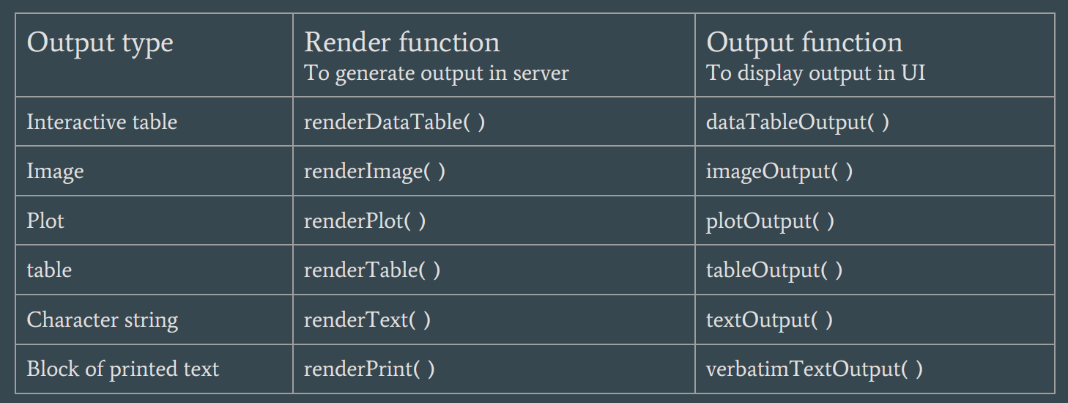
Render functions

Slide 11
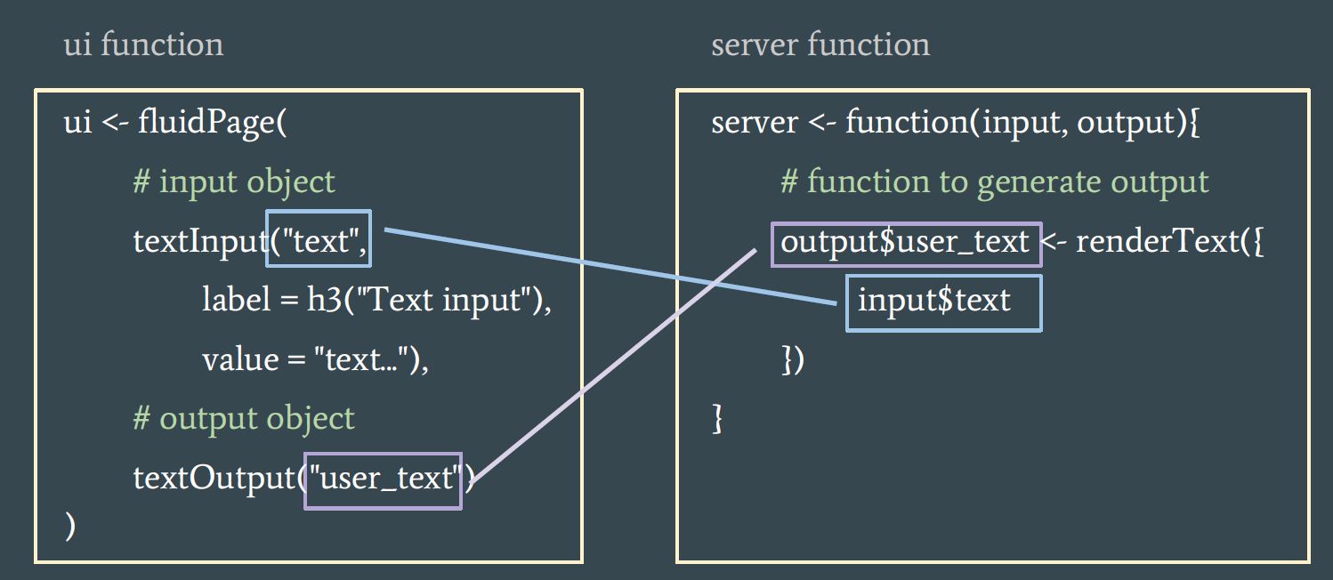
Input and output interactions

Slide 12
demo

